Slide 1
Exoplanet Transit Model
Work in Progress

Slide 2
Exoplanets
One of the primary ways we learn about far-off exoplanets is through their “transit” of a star
When exoplanets pass in front of a star, we can measure the change in that stars’ brightness
This is known as the “flux”

Slide 3
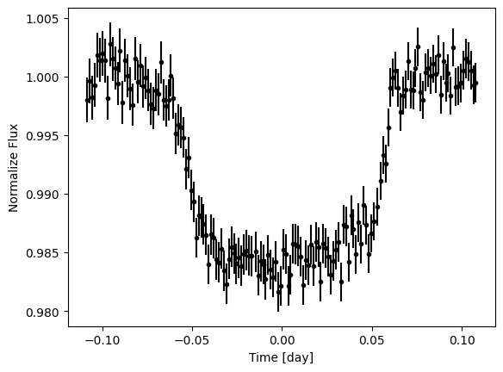
Transit Data
This data shows the change in brightness of a star that has an exoplanet transiting
We can see that the brightness is reduced by a little less than 2%
But how can we model this data?

Slide 4
Hypothesis
This data appears as to have an approximately parabolic shape
Maybe we can model the transit using a transformed cosine wave

Slide 5
y = A cos(k( x – h)) + k
This is the cosine formula!
A: amplitude
k: 2pi / period
h: horizontal shift
k: vertical shift

Slide 6
To solve, we’re going to approximate a least squares algorithm.

Slide 7
To solve, we’re going to approximate a least squares algorithm.
Translation: We’re going to try a bunch of numbers until the line passes the eye test

Slide 8
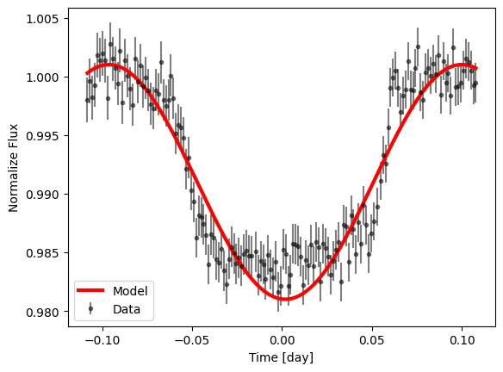
Result
Hey that looks pretty close!
y = (1/100) * cos(32 * (t - .1)) + .991
Some flaws are already apparent, but let’s see how it performs vs other models

Slide 9
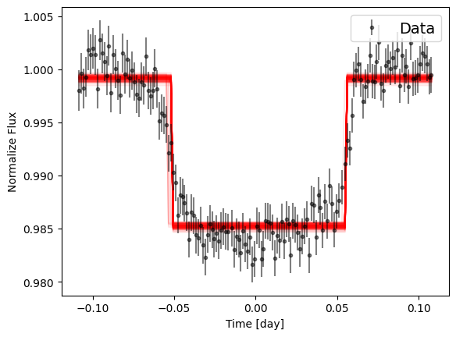
Chi^2 of rectangular model:
1.6071797161348398
Chi^2 of cos model:
1.9170438700166612

Slide 10
Conclusion
While this model got close, it appears to be fundamentally flawed
”Trough” of data appears flat, not curved
Curls at top of graph, data must start right when transit does
Trapezoid model even closer than rectangle

